Slide 1
Collective Spammer Detection in
Evolving Multi-Relational Social Networks
Shobeir Fakhraei (University of Maryland)
James Foulds (University of California, Santa Cruz)
Madhusudana Shashanka (if(we) Inc., Currently Niara Inc.)
Lise Getoor (University of California, Santa Cruz)
Notes:
Thanks for the introduction. This is joint work with my colleagues from the University of Maryland, the University of California Santa Cruz, and Niara Inc. Two authors of this paper, Shobeir Fakhraei and Madhu Shashanka, performed much of this study while at if(we), formerly known as Tagged incorporated.

Slide 2
Spam in Social Networks
Recent study by Nexgate in 2013:
  Spam grew by more than 300% in half a year
Notes:
In this work, we address the problem of detecting spam in social networks. This is a growing problem: a recent study performed by Nexgate in 2013 found that the amount of spam had tripled in just half a year,

Slide 3
Spam in Social Networks
Recent study by Nexgate in 2013:
  Spam grew by more than 300% in half a year
  1 in 200 social messages are spam
Notes:
as many as 1 in 200 social messages are spam,

Slide 4
Spam in Social Networks
Recent study by Nexgate in 2013:
  Spam grew by more than 300% in half a year
  1 in 200 social messages are spam
  5% of all social apps are spammy
Notes:
and 5% of all social apps are spammy in nature.

Slide 5
Spam in Social Networks
What’s different about social networks?
  Spammers have more ways to interact with users
Notes:
So what’s different about social media and social networks which makes them such a target for spammers, compared to the traditional web or to email?
For a start, spammers have more ways to interact with users, including

Slide 6
Spam in Social Networks
What’s different about social networks?
  Spammers have more ways to interact with users
    Messages, comments on photos, winks,…
Notes:
private messages, comments on photos, winks, and other interactive actions that can be directed at users. The social context of these interactions can be used to conceal a spammer’s intentions.

Slide 7
Spam in Social Networks
What’s different about social networks?
  Spammers have more ways to interact with users
    Messages, comments on photos, winks,…
  They can split spam across multiple messages
Notes:
Spammers can also obfuscate the malicious nature of their content by splitting it across multiple messages, which poses challenges for traditional content-based spam filters, as well as for the human targets of spam.

Slide 8
Spam in Social Networks
What’s different about social networks?
  Spammers have more ways to interact with users
    Messages, comments on photos, winks,…
  They can split spam across multiple messages
  More available info about users on their profiles!
Notes:
Social networks also typically make more information about users available to spammers, including information on their profiles, and their friendship links, which can be leveraged by spammers for targeted attacks.

Slide 9
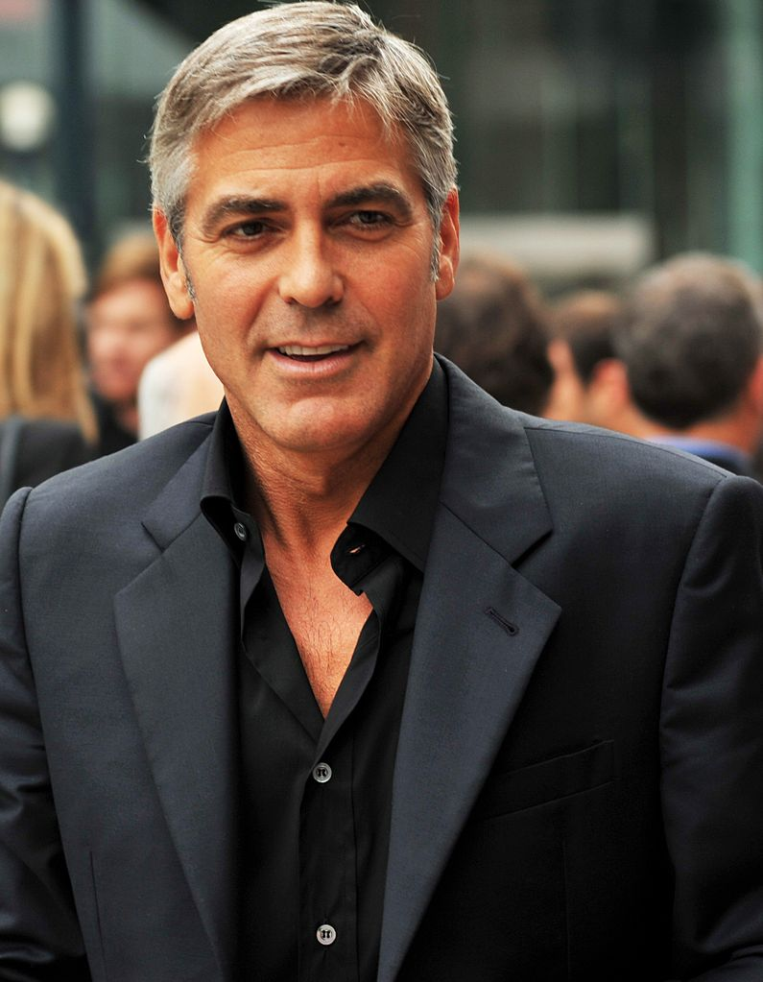

Spammers are getting smarter!
Traditional Spam:
Want some replica luxury watches?
Click here:
http://SpammyLink.com
George
Shobeir
Notes:
Furthermore, spammers are getting smarter at social spam. Previously a spam attack on a social network would look something like this. Here, the spam account named “George” messages a legitimate user of the social network. In this case, the user happens to be Shobeir, who is the first author of this paper. George says to Shobeir: […].

Slide 10
Spammers are getting smarter!
Traditional Spam:
Want some replica luxury watches?
Click here:
http://SpammyLink.com
George
 [Report Spam]
Shobeir
Notes:
Shobeir easily identifies and reports this message as spam, due to the sketchy content of the message, combined with the clearly fake photo of George Clooney, and a lack of trust for the strange user “George.”

Slide 11

Spammers are getting smarter!
Traditional Spam:
(Intelligent) Social Spam:
Want some replica luxury watches?
Click here:
http://SpammyLink.com
Hey Shobeir!
Nice profile photo. I live in Bay Area too. Wanna chat?
George
Mary
 [Report Spam]
Shobeir
Shobeir
Notes:
More recently, sophisticated social spam attacks aim to avoid detection by exploiting the social nature of the platforms. In the example on the right, the spam account “Mary” messages Shobeir, […].

Slide 12
Spammers are getting smarter!
Traditional Spam:
(Intelligent) Social Spam:
Want some replica luxury watches?
Click here:
http://SpammyLink.com
Hey Shobeir!
Nice profile photo. I live in Bay Area too. Wanna chat?
George
Mary
 [Report Spam]
Sure! :)
Shobeir
Shobeir
Notes:
Shobeir is unaware that Mary is a spammer, so he agrees: “Sure!”

Slide 13
Spammers are getting smarter!
Traditional Spam:
(Intelligent) Social Spam:
Want some replica luxury watches?
Click here:
http://SpammyLink.com
Hey Shobeir!
Nice profile photo. I live in Bay Area too. Wanna chat?
George
Mary
 [Report Spam]
Sure! :)
Shobeir
Shobeir
Realistic Looking Conversation
…
I’m logging off here., too many people pinging me!
I really like you, let’s chat more here:
http://SpammyLink.com
Mary
Notes:
The spam account engages Shobeir in a realistic-looking conversation, and finally signs off by saying “[…].” This sophisticated social spammer is much more likely to avoid detection by algorithmic spam filters, and by the user. The spammy content is hidden within a larger amount of realistic social dialogue, which can confound content-based filters. It has also engaged the user’s interest and gained their trust, making the user much more likely to click on the link. Sophisticated spammers can also randomize the link, and even spread the link across multiple messages, to avoid detection by content-based spam filters.

Slide 14

Tagged.com
Founded in 2004, is a social networking site which connects people through social interactions and games
Over 300 million registered members
Data sample for experiments (on a laptop):
  5.6 Million users (3.9% Labeled Spammers)
  912 Million Links
Notes:
In this paper, we aim to find such social spammers in social media websites. We are particularly motivated by the site Tagged.com, although our approach can be applied more broadly to any multi-relational network, which includes all modern digital social networks. Our motivating site, Tagged, is a social networking site which connects people through social interactions and games. Tagged is kind of the opposite of Facebook – you go on Facebook to chat with the friends you already have, while you go on Tagged to make new friends that you don’t already have. Tagged was founded in 2004, and has over 300 million registered members. We analyzed a subset of the data containing 5.6 million users, of which around 4% were labeled as spammers. The subset includes 912 million interaction links between users.

Slide 15
Social Networks:
Multi-relational and Time-Evolving
Notes:
Spam detection in social networks such as Tagged.com can be formalized as a classification problem in a multi-relational, time-evolving network.

Slide 16
Social Networks:
Multi-relational and Time-Evolving
Legitimate users
Notes:
The nodes of the network can be categorized as either legitimate users,

Slide 17
Social Networks:
Multi-relational and Time-Evolving
Legitimate users
Spammers
Notes:
or spammers, and the goal is to classify the nodes into these two categories.

Slide 18
Social Networks:
Multi-relational and Time-Evolving
Legitimate users
Spammers
Link = Action at time t
Actions = Profile view, message, poke, report abuse, etc
Notes:
The graph consists of links between users, which correspond to actions that the users take, and which are associated with a timestamp. In Tagged, the possible actions include viewing profiles, messaging, pokes, winks, reporting abuse, and so on.

Slide 19
Social Networks:
Multi-relational and Time-Evolving
Link = Action at time t
Actions = Profile view, message, poke, report abuse, etc
Notes:
To make the problem formulation concrete, let’s look at the example network shown in this graph.

Slide 20
Social Networks:
Multi-relational and Time-Evolving
Profile view
Link = Action at time t
Actions = Profile view, message, poke, report abuse, etc
Notes:
At time t = 1, a spammer views the profile of a legitimate user.

Slide 21
Social Networks:
Multi-relational and Time-Evolving
Profile view
Message
Link = Action at time t
Actions = Profile view, message, poke, report abuse, etc
Notes:
At time t=2, the user messages another legitimate user.

Slide 22
Social Networks:
Multi-relational and Time-Evolving
Profile view
Message
Poke
Link = Action at time t
Actions = Profile view, message, poke, report abuse, etc
Notes:
Then, at t=3, another user unknowingly pokes an account that happens to be a spammer.

Slide 23
Social Networks:
Multi-relational and Time-Evolving
Profile view
Message
Report
spammer
Poke
Link = Action at time t
Actions = Profile view, message, poke, report abuse, etc
Notes:
At time t=4, a different user reports the spammer to the site administrators, allowing the identification of the spam account. It should be noted that while user reporting of spammers provides a strong signal for spam detection, it has limitations in terms of coverage of the spammers, and is also noisy, so it is insufficient by itself to rapidly and accurately identify all spammers in the network.

Slide 24
Our Approach
Predict spammers based on:
Graph structure
Action sequences
Reporting behavior
Notes:
Having described the setting, I can now introduce our novel approach to detecting spammers in social networks, and specifically the Tagged.com network. Spammers are using the social nature of social networks to disguise their activities. Our approach fights fire with fire, by using the social network itself to FIND the spammers. We propose to classify spammers based on three types of signal: the graph structure of the multi-relational network, the sequences of actions performed by the users, and the abuse reporting behavior of the accounts.
Note that we do not consider content information here, for several reasons. Firstly, in social networks content-free methods are preferable for privacy reasons, to the extent that this is possible. Content-based filters are also more easily manipulated by spammers. Here, we are mainly interested in detecting the sophisticated spammers that have already passed traditional spam detection methods, including content-based filters. In any case, our method can also easily be combined with content-based systems if this is desired in a deployed system.

Slide 25
Our Approach
Predict spammers based on:
Graph structure
Action sequences
Reporting behavior
Notes:
Let’s start with the first part of our approach: using the graph structure information to detect spammers.

Slide 26
Graph Structure Feature Extraction
Graphs for each relation
Notes:
We begin by extracting graphs for each relation, where each relation corresponds to a type of action in the network. For instance, we extract the message graph between users, the friend request graph, the wink graph, and so on.

Slide 27
Graph Structure Feature Extraction
Features
Graphs for each relation
Notes:
We then extract a number of features from the graphs for each relation, thereby representing each user in the social network with a feature vector.

Slide 28
Graph Structure Features
Extract features for each relation graph es for each of 10 rel
  PageRank
  Degree statistics
    Total degree
    In degree
    Out degree
  k-Core
  Graph coloring
  Connected components
  Triangle count
(8 features for each of 10 relations)
Notes:
For each relation graph, we extract the following 8 types of features for each node in the network:

Slide 29
Graph Structure Features
Extract features for each relation graph es for each of 10 rel
  PageRank
  Degree statistics
    Total degree
    In degree
    Out degree
  k-Core
  Graph coloring
  Connected components
  Triangle count
(8 features for each of 10 relations)
Notes:
The pagerank of the node,

Slide 30
Graph Structure Features
Extract features for each relation graph es for each of 10 rel
  PageRank
  Degree statistics
    Total degree
    In degree
    Out degree
  k-Core
  Graph coloring
  Connected components
  Triangle count
(8 features for each of 10 relations)
Notes:
and its degree statistics, including the total degree, and its in-degree and out-degree. Intuitively, these features measure the extent to which the node is connected to the rest of the network.

Slide 31
Graph Structure Features
Extract features for each relation graph es for each of 10 rel
  PageRank
  Degree statistics
    Total degree
    In degree
    Out degree
  k-Core
  Graph coloring
  Connected components
  Triangle count
(8 features for each of 10 relations)
Notes:
We compute the k-core of the nodes, which is a centrality measure that is computed by recursively pruning the least-connected vertices. The k-core value of each node is the iteration in which it is pruned. More central nodes will get pruned later, and so will have higher k-core values.

Slide 32
Graph Structure Features
Extract features for each relation graph es for each of 10 rel
  PageRank
  Degree statistics
    Total degree
    In degree
    Out degree
  k-Core
  Graph coloring
  Connected components
  Triangle count
(8 features for each of 10 relations)
Notes:
We also perform graph coloring, and encode the color identifier of each node as a feature.

Slide 33
Graph Structure Features
Extract features for each relation graph es for each of 10 rel
  PageRank
  Degree statistics
    Total degree
    In degree
    Out degree
  k-Core
  Graph coloring
  Connected components
  Triangle count
(8 features for each of 10 relations)
Notes:
We compute the weakly connected components of the graphs, and extract component identifiers, and the size of the components, as features.

Slide 34
Graph Structure Features
Extract features for each relation graph es for each of 10 rel
  PageRank
  Degree statistics
    Total degree
    In degree
    Out degree
  k-Core
  Graph coloring
  Connected components
  Triangle count
(8 features for each of 10 relations)
Notes:
Finally, we count the number of triangles in the graph that each vertex participates in. The triangle count is a measure of the connectivity of the graph around the node. Triangles are also considered important structures in social network theories such as triadic closure and balance theory.

Slide 35
Graph Structure Features
Extract features for each relation graph es for each of 10 rel
  PageRank
  Degree statistics
    Total degree
    In degree
    Out degree
  k-Core
  Graph coloring
  Connected components
  Triangle count
X
(8 features for each of 10 relations)
Notes:
These 8 kinds of features are extracted for each of the ten relations in the multi-relational network, which are:

Slide 36
Graph Structure Features
Extract features for each relation graph es for each of 10 rel
  PageRank
  Degree statistics
    Total degree
    In degree
    Out degree
  k-Core
  Graph coloring
  Connected components
  Triangle count
  Viewing profile
  Friend requests
  Message
  Luv
  Wink
  Pets game
    Buying
    Wishing
  MeetMe game
    Yes
    No
  Reporting abuse
X
(8 features for each of 10 relations)
Notes:
Viewing user profiles, friend requests, sending messages, sending luv, sending winks, the buying and wishing actions in the interactive pets game, yes or no responses in the MeetMe game, and reporting abuse in the network.

Slide 37



Graph Structure Features
Viewing profile
…
Reporting abuse
t(1)
…
t(6)
t(5)
t(3)
t(10)
t(4)
Graph Structure
t(7)
t(8)
Triangle Count
Graph Coloring
Triangle Count
Graph Coloring
Out-Degree
Out-Degree
t(8)
t(3)
t(2)
PageRank
In-Degree
PageRank
In-Degree
t(9)
k-Core
k-Core
…
Classification method: Gradient Boosted Trees
Notes:
After feature extraction from the multi-relational network, we have encoded each user with a feature vector capturing key properties of the graph structure relating to that user. We can then apply standard supervised classification techniques. In this work we use gradient boosted decision trees, which are a relatively powerful and flexible ensemble approach for building a non-linear classifier, although we could also plug in any other classification algorithm here.

Slide 38
Graph Structure Features
Experiments | AU-PR | AU-ROC
1 Relation, 8 Feature types | 0.187 ± 0.004 | 0.803 ±0.001
10 Relations, 1 Feature type | 0.285 ± 0.002 | 0.809 ± 0.001
10 Relations, 8 Feature types | 0.328 ± 0.003 | 0.817 ± 0.001
Multiple relations/features better performance!
Notes:
Here are some experimental results for spammer classification using the graph structure features alone.

Slide 39
Graph Structure Features
Experiments | AU-PR | AU-ROC
1 Relation, 8 Feature types | 0.187 ± 0.004 | 0.803 ±0.001
10 Relations, 1 Feature type | 0.285 ± 0.002 | 0.809 ± 0.001
10 Relations, 8 Feature types | 0.328 ± 0.003 | 0.817 ± 0.001
Multiple relations/features better performance!
Notes:
First, if we use all 8 features for only one relation in the multi-relational network, the result for the best-performing relation is an area under the precision-recall curve of 0.187, and an AU-ROC of 0.803.

Slide 40
Graph Structure Features
Experiments | AU-PR | AU-ROC
1 Relation, 8 Feature types | 0.187 ± 0.004 | 0.803 ±0.001
10 Relations, 1 Feature type | 0.285 ± 0.002 | 0.809 ± 0.001
10 Relations, 8 Feature types | 0.328 ± 0.003 | 0.817 ± 0.001
Multiple relations/features better performance!
Notes:
If we instead use all 10 relations but only one feature type, the best performing feature gives better results. The best performing feature was the pageRank of the users, which gave an AU-PR of 0.285 and an AU-ROC of 0.809 when used with all 10 relation types. So it is better to use multiple relations than to use multiple features, if we could only choose one of these options.

Slide 41
Graph Structure Features
Experiments | AU-PR | AU-ROC
1 Relation, 8 Feature types | 0.187 ± 0.004 | 0.803 ±0.001
10 Relations, 1 Feature type | 0.285 ± 0.002 | 0.809 ± 0.001
10 Relations, 8 Feature types | 0.328 ± 0.003 | 0.817 ± 0.001
Multiple relations/features better performance!
Notes:
Of course, we can use both multiple relations and multiple features. We find that the performance improves again when using all 10 relations and all 8 feature types, with an AU-PR of 0.328 and an AU-ROC of 0.817. So, using BOTH multiple relations and multiple features leads to better performance.

Slide 42
Our Approach
Predict spammers based on:
Graph structure
Action sequences
Reporting behavior
Notes:
So far, our approach has considered the graph structure of the multi-relational social network, but we haven’t yet leveraged the temporal information in the network. We make use of the dynamic nature of the social network by analyzing the sequences of actions performed by the users. Our hypothesis was that most spammers are computer programs, and their pre-defined behavior in terms of the sequences of actions performed may give away their automated nature.
It is important to note that sequence mining is only possible because social networks are multi-relational, i.e. there are multiple types of interaction between the users, and they are dynamic, with the interactions occurring over time. This is in contrast to the traditional notion that social networks can be understood by analyzing just one adjacency matrix.

Slide 43
Sequence of Actions
Sequential Bigram Features:
Short sequence segment of 2 consecutive actions, to capture sequential information
User1 Actions:
Message, Profile_view, Message, Friend_Request, ….
Notes:
A simple approach to extracting feature vectors from sequential information is to compute counts of k-gram features, such as bigrams. In this example, user 1 performed the actions: “Message, Profile view, Message, Friend request.” We count the number of occurrences of pairs of consecutive actions, e.g. Message followed by Profile View, using a sliding window of length 2.

Slide 44
Sequence of Actions
Mixture of Markov Models (MMM):
  A.k.a. chain-augmented, tree-augmented naive Bayes
Notes:
We also used a more sophisticated probabilistic model-based approach for classifying sequence data. Our model posits that the data are generated via a mixture of Markov models, as shown in the graphical model diagram and joint distribution on the slide. In the model, each class, spammer and non-spammer, is associated with a Markov chain which generates the sequence of actions for the user. This type of model is sometimes called a chain-augmented or tree-augmented naïve Bayes model. We train the model via MAP estimation, and compute the log posterior probability of the classes, as well as the odds and log-odds of the classes, and include these values as features for the classifier.

Slide 45
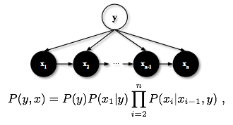
Sequence of Actions
t(1)
t(6)
t(5)
t(3)
t(10)
t(4)
t(7)
t(8)
t(8)
t(3)
t(2)
t(9)
Bigram Features
Chain Augmented NB
Action Sequence
…
+
Notes:
After combining the bigram features and the predictions from the probabilistic model into a feature vector for each user, we construct a classifier on the feature vectors to predict spammers.

Slide 46
Sequence of Actions
Experiments | AU-PR | AU-ROC
Bigram Features | 0.471 ± 0.004 | 0.859 ± 0.001
MMM | 0.246 ± 0.009 | 0.821 ± 0.003
Bigram + MMM | 0.468 ± 0.012 | 0.860 ± 0.002
Little benefit from MMM (although little overhead)
Notes:
This slide shows results for using the sequence-based features in isolation. We find that the mixture of Markov models provides little benefit to the classifier over the simple bigram features. However, it also does not add much computational overhead when we are already computing bigrams, so we still include the features from the probabilistic model in our final approach. The classifier with bigrams and the predictions from the mixture of Markov models has an AUPR of 0.468 and an AU-ROC of 0.86.

Slide 47
Results
Precision-Recall ROC
We can classify 70% of the spammers that need manual labeling with about 90% accuracy
Notes:
Here are full experimental results for each of the classifiers using the different feature types. All of our results were obtained using 10-fold cross validation. We obtain ground truth spammer labels from the set of accounts that were flagged and deactivated by Tagged.com’s administration team in the time since our data sample was collected.
On the left is the precision-recall curve, and on the right is the ROC curve. We find that the sequence features, shown in green, perform better than the graph structure features, shown in red. However, a classifier with both graph features and sequence features together performs better than either feature type by itself, as we can see from the light blue curve.
Finally, for the complete model we additionally include three demographic features: age, gender, and time since registration. Age and gender improved the classification results as they are indicative of behavioral patterns, e.g. the way that teenage girls behave is different to the way that 50 year-old men behave – or at least, one would hope so! The non-linear classifier can leverage these patterns during classification. The age of the account is also a useful signal because legitimate users are typically in the system longer. The full classifier with all features performs the best, as shown in the dark blue curve. Using the classifier with all features, we could detect about 70% of the spammers that had passed traditional filters and needed manual labeling, with around 90% precision.

Slide 48
Deployment and Example Runtimes
We can:
  Run the model on short intervals, with new snapshots
  of the network
  Update the features as events occur
Example runtimes with Graphlab CreateTM on a Macbook Pro:
  5.6 million vertices and 350 million edges:
  PageRank: 6.25 minutes
  Triangle counting: 17.98 minutes
  k-core: 14.3 minutes
Notes:
To deploy this model in practice on the Tagged.com platform, the model can be repeatedly retrained on relatively short intervals in order to adapt to adversarial reactions by spammers. The features can be computed in parallel, and many of them can be kept up to date incrementally as events occur in the network. Even computing the features from scratch is not computationally difficult, especially at an industrial scale, as we were able to compute the features in minutes using Graphlab Create on a single Macbook Pro laptop.

Slide 49
Our Approach
Predict spammers based on:
Graph structure
Action sequences
Reporting behavior
Notes:
So far, we have used the graph structure and the action sequence information to detect spammers in social networks. In the third and final part of our approach, we make specific use of the abuse reporting systems available in social media platforms such as Tagged.com to detect spammers.

Slide 50
Refining the abuse reporting systems
Abuse report systems are very noisy
  People have different standards
  Spammers report random people to increase noise
  Personal gain in social games
Goal is to clean up the system using:
  Reporters’ previous history
  Collective reasoning over reports
Notes:
Like many social networks, Tagged.com provides an interface for users to report other users for their abuses of the system, such as spamming. This reporting system is valuable as it very directly identifies spammers for us. However, the reporting systems are very noisy, for several reasons. People have different standards for labeling users as spammers, which can lead to errors. More dangerously, there are adversarial reasons for errors in the reporting system. Spammers report legitimate users as spammers in order to increase the noise in the system, and even human users abuse the reporting system by reporting their opponents in social games.
Our goal, then, is to clean up the results of the reporting system. We accomplish this by making use of the reporters’ previous history, as well as collective reasoning over the graph of report actions in the social network.

Slide 51
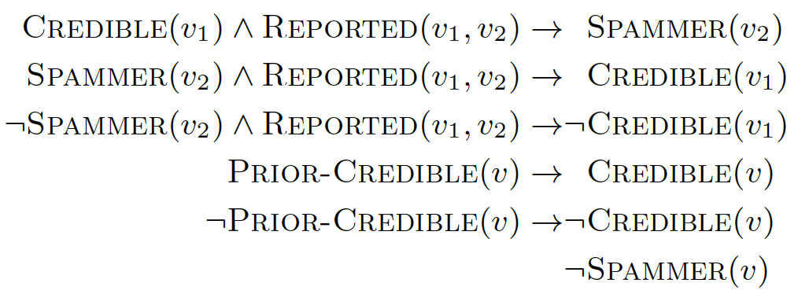
Collective Classification with Reports
t(1)
t(6)
t(5)
t(3)
t(10)
t(4)
t(7)
t(8)
t(8)
t(3)
t(2)
t(9)
Probabilistic Soft Logic
Report Subgraph
Notes:
More specifically, we use a graphical modeling approach to clean up the reporting system. Using a logic-based modeling language, we define a graphical model for jointly inferring the spam class labels together with the credibility of the users at reporting spammers. The graphical model allows us to propagate label information across the network.

Slide 52
HL-MRFs & Probabilistic Soft Logic (PSL)
Probabilistic Soft Logic (PSL), a declarative modeling language based on first-order logic
Weighted logical rules define a probabilistic graphical model:
Instantiated rules reduce the probability of any state that does not satisfy the rule, as measured by its
distance to satisfaction
52
Notes:
We construct a specific kind of graphical model called a hinge-loss Markov random field, which is a type of undirected graphical model over continuous random variables, where the feature functions are hinge functions. These models are highly scalable, and can be specified using a declarative modeling language called probabilistic soft logic, PSL. A program in the PSL language specifies a graphical model via weighted logical rules. The rules are instantiated as potential functions in the resulting hinge-loss MRF graphical model, which penalize the probability of a state that does not satisfy the rule, as measured by its “distance to satisfaction .” PSL and hinge-loss MRFs were developed in Lise Getoor’s group at the University of Maryland, and now the University of California, Santa Cruz.

Slide 53
Collective Classification with Reports
Model using only reports:
Notes:
We begin with a baseline PSL model which uses the reports but performs no further reasoning. This model consists of two simple rules. The first rule simply states that users that are reported as spammers are in fact more likely to be spammers. The second rule encodes the prior knowledge that most users are not spammers.

Slide 54
Collective Classification with Reports
Model using reports and credibility of
the reporter:
Notes:
We then extend this model to make use of the credibility of the reporter. Here, the credibility of each user is a latent variable which is also inferred along with the class labels. The first rule states that IF user v1 is credible AND they reported user v2, then v2 is more likely to be a spammer. The next two rules encourage the latent credibility variables for each user to be similar to a prior guess at the user’s credibility, which we obtain from their accuracy on the training data.

Slide 55
Collective Classification with Reports
Model using reports, credibility of the reporter, and collective reasoning:
Notes:
The final model is an MRF for jointly inferring the spammer status of the users together with their credibility for reporting spammers. The first three rules encode the collective reasoning in the model:
IF user v1 is credible AND they reported v2 as a spammer, then v2 is likely to be a spammer.
If v2 is a spammer AND v1 reported them, then V1 got it right, and so they are likely to be credible, and we should believe them next time.
If, on the other hand, v2 is NOT a spammer then v1 got it wrong, and so they are not likely to be credible, and we shouldn’t believe their other predictions, either.

Slide 56
Results of Classification Using Reports
Experiments | AU-PR | AU-ROC
Reports Only | 0.674 ± 0.008 | 0.611 ± 0.007
Reports & Credibility | 0.869 ± 0.006 | 0.862 ± 0.004
Reports & Credibility & Collective Reasoning | 0.884 ± 0.005 | 0.873 ± 0.004
Notes:
Now that we have defined our models, here are the results of our cross-validation experiments for spammer classification using abuse reports.

Slide 57
Results of Classification Using Reports
Experiments | AU-PR | AU-ROC
Reports Only | 0.674 ± 0.008 | 0.611 ± 0.007
Reports & Credibility | 0.869 ± 0.006 | 0.862 ± 0.004
Reports & Credibility & Collective Reasoning | 0.884 ± 0.005 | 0.873 ± 0.004
Notes:
We find that the model which simply uses the reports …

Slide 58
Results of Classification Using Reports
Experiments | AU-PR | AU-ROC
Reports Only | 0.674 ± 0.008 | 0.611 ± 0.007
Reports & Credibility | 0.869 ± 0.006 | 0.862 ± 0.004
Reports & Credibility & Collective Reasoning | 0.884 ± 0.005 | 0.873 ± 0.004
Notes:
…is beaten by the model which also makes use of the credibility of the users, …

Slide 59
Results of Classification Using Reports
Experiments | AU-PR | AU-ROC
Reports Only | 0.674 ± 0.008 | 0.611 ± 0.007
Reports & Credibility | 0.869 ± 0.006 | 0.862 ± 0.004
Reports & Credibility & Collective Reasoning | 0.884 ± 0.005 | 0.873 ± 0.004
Notes:
…which in turn is beaten by the model that performs collective reasoning to infer credibility together with the spam labels. The final model achieves an AU-PR of 0.884 and an AU-ROC of 0.873.

Slide 60
Conclusion
Multiple relations are more predictive than multiple features
…
Graph Structure
AUPR:
0.187 → 0.328
t(1)
Triangle Count
Graph Coloring
Triangle Count
Graph Coloring
Out-Degree
Out-Degree
PageRank
In-Degree
PageRank
In-Degree
t(3)
k-Core
k-Core
t(6)
t(5)
t(10)
t(4)
t(7)
…
t(3)
t(8)
t(2)
t(8)
t(9)
Code and part of the data will be released soon:
https://github.com/shobeir/fakhraei_kdd2015
Notes:
To conclude, our approach for detecting spammers in social networks such as Tagged.com has three components. We first build a classifier by extracting features from the graph structure of each of the relations in the multi-relational network.

Slide 61
Conclusion
Multiple relations are more predictive than multiple features
…
Graph Structure
AUPR:
0.187 → 0.328
t(1)
Triangle Count
Graph Coloring
Triangle Count
Graph Coloring
Out-Degree
Out-Degree
PageRank
In-Degree
PageRank
In-Degree
t(3)
k-Core
k-Core
t(6)
t(5)
t(10)
t(4)
t(7)
…
t(3)
t(8)
t(2)
t(8)
Even simple bigrams are highly predictive
t(9)
Bigram Features
Chain Augmented NB
Action Sequence
+
…
AUPR: 0.471
Code and part of the data will be released soon:
https://github.com/shobeir/fakhraei_kdd2015
Notes:
We then extract features from the sequence information of the users’ actions.

Slide 62
Conclusion
Multiple relations are more predictive than multiple features
…
Graph Structure
AUPR:
0.187 → 0.328
Can classify 70% of the spammers that needed manual labeling with 90% accuracy
t(1)
Triangle Count
Graph Coloring
Triangle Count
Graph Coloring
Out-Degree
Out-Degree
PageRank
In-Degree
PageRank
In-Degree
t(3)
k-Core
k-Core
t(6)
t(5)
t(10)
t(4)
t(7)
…
t(3)
t(8)
t(2)
t(8)
Even simple bigrams are highly predictive
AUPR: 0.779
t(9)
Bigram Features
Chain Augmented NB
Action Sequence
+
…
AUPR: 0.471
Code and part of the data will be released soon:
https://github.com/shobeir/fakhraei_kdd2015
Notes:
Using both feature types together improved performance, especially when combined with simple demographic features. The full classifier had an AUPR of 0.779, and it could identify 70% of the spammers that passed Tagged.com’s deployed spam filtering, at a precision of 90%.

Slide 63
Conclusion
Multiple relations are more predictive than multiple features
…
Graph Structure
AUPR:
0.187 → 0.328
Can classify 70% of the spammers that needed manual labeling with 90% accuracy
t(1)
Triangle Count
Graph Coloring
Triangle Count
Graph Coloring
Out-Degree
Out-Degree
PageRank
In-Degree
PageRank
In-Degree
t(3)
k-Core
k-Core
t(6)
t(5)
t(10)
t(4)
t(7)
…
t(3)
t(8)
t(2)
t(8)
Even simple bigrams are highly predictive
AUPR: 0.779
t(9)
Bigram Features
Chain Augmented NB
Action Sequence
+
…
AUPR: 0.471
Probabilistic Soft Logic
Jointly refining the credibility of the source is highly effective!
Report Subgraph
AUPR:
0.674 → 0.884
Code and part of the data will be released soon:
https://github.com/shobeir/fakhraei_kdd2015
Notes:
In a complementary approach, we also showed how to refine the outputs of the abuse reporting system by using a graphical model to perform collective classification and jointly infer the latent spam reporting credibility of each user together with the spam labels of the users. This improved the AUPR of the spam reporting system from 0.674 to 0.884.
We will release our code and a subset of the data at the URL at the bottom of the slide.

Slide 64


Acknowledgements
Lise Getoor
Univ. California, Santa Cruz
Collaborators:
If(we) Inc. (Formerly Tagged Inc.):
Johann Schleier-Smith, Karl Dawson, Dai Li, Stuart Robinson, Vinit Garg, and Simon Hill
Dato (Formerly Graphlab):
Danny Bickson, Brian Kent, Srikrishna Sridhar, Rajat Arya, Shawn Scully, and Alice Zheng
Shobeir Fakhraei
Univ. of Maryland
Madhusudana Shashanka
if(we) Inc., currently Niara Inc.
Notes:
Before concluding the talk, I would like to thank my collaborators: Shobeir Fakhraei from the University of Maryland, who performed the majority of this work, partly during an internship at Tagged.com, as well as Lise Getoor from UCSC and Madhu Shashanka from if(we), formerly known as Tagged Inc, and who is currently at Niara .
Shobeir would also like to thank many colleagues from If(we) and Dato, formerly known as Graphlab.

Slide 65
Conclusion
Thank you!
Multiple relations are more predictive than multiple features
…
Graph Structure
AUPR:
0.187 → 0.328
Can classify 70% of the spammers that needed manual labeling with 90% accuracy
t(1)
Triangle Count
Graph Coloring
Triangle Count
Graph Coloring
Out-Degree
Out-Degree
PageRank
In-Degree
PageRank
In-Degree
t(3)
k-Core
k-Core
t(6)
t(5)
t(10)
t(4)
t(7)
…
t(3)
t(8)
t(2)
t(8)
Even simple bigrams are highly predictive
AUPR: 0.779
t(9)
Bigram Features
Chain Augmented NB
Action Sequence
+
…
AUPR: 0.471
Probabilistic Soft Logic
Jointly refining the credibility of the source is highly effective!
Report Subgraph
AUPR:
0.674 → 0.884
Code and part of the data will be released soon:
https://github.com/shobeir/fakhraei_kdd2015
Notes:
Thanks very much for your attention!

