Slide 1
Annealing Paths for the Evaluation of Topic Models
James Foulds
Padhraic Smyth
Department of Computer Science
University of California, Irvine*
*James Foulds has recently moved to the University of California, Santa Cruz

Slide 2
Motivation
Topic model extensions
Structure, prior knowledge and constraints
Sparse, nonparametric, correlated, tree-structured, time series, supervised, focused, determinantal…
Special-purpose models
Authorship, scientific impact, political affiliation, conversational influence, networks, machine translation…
General-purpose models
Dirichlet multinomial regression (DMR),
sparse additive generative (SAGE)…
Structural topic model (STM)

Slide 3
Motivation
Topic model extensions
Structure, prior knowledge and constraints
Sparse, nonparametric, correlated, tree-structured, time series, supervised, focused, determinantal…
Special-purpose models
Authorship, scientific impact, political affiliation, conversational influence, networks, machine translation…
General-purpose models
Dirichlet multinomial regression (DMR),
sparse additive generative (SAGE)…
Structural topic model (STM)

Slide 4
Motivation
Topic model extensions
Structure, prior knowledge and constraints
Sparse, nonparametric, correlated, tree-structured, time series, supervised, focused, determinantal…
Special-purpose models
Authorship, scientific impact, political affiliation, conversational influence, networks, machine translation…
General-purpose models
Dirichlet multinomial regression (DMR),
sparse additive generative (SAGE),
Structural topic model (STM), …

Slide 5
Motivation
Inference algorithms for topic models
Optimization
EM, variational inference, collapsed variational inference,…
Sampling
Collapsed Gibbs sampling, Langevin dynamics,…
Scaling to ``big data’’
Stochastic algorithms, distributed algorithms,
map reduce…

Slide 6
Motivation
Inference algorithms for topic models
Optimization
EM, variational inference, collapsed variational inference,…
Sampling
Collapsed Gibbs sampling, Langevin dynamics,…
Scaling to ``big data’’
Stochastic algorithms, distributed algorithms,
map reduce…

Slide 7
Motivation
Inference algorithms for topic models
Optimization
EM, variational inference, collapsed variational inference,…
Sampling
Collapsed Gibbs sampling, Langevin dynamics,…
Scaling up to ``big data’’
Stochastic algorithms, distributed algorithms,
map reduce, sparse data structures…

Slide 8
Motivation
Which existing techniques should we use?
Is my new model/algorithm better than previous methods?

Slide 9
Evaluating Topic Models
Training set
Test set

Slide 10
Evaluating Topic Models
Topic model
Training set
Test set

Slide 11
Evaluating Topic Models
Topic model
Predict:
Training set
Test set

Slide 12
Evaluating Topic Models
Log Pr( )
Topic model
Predict:
Training set
Test set

Slide 13
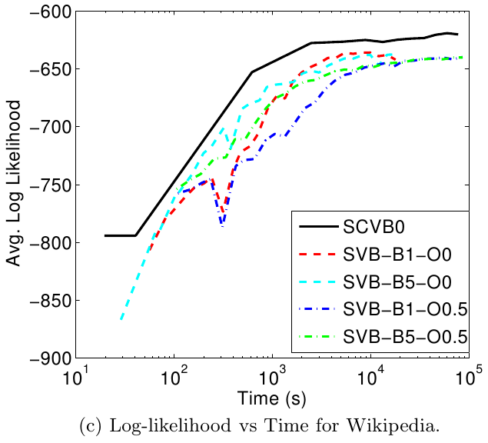
Evaluating Topic Models
Fitting these models only took a few hours on a single core single core machine.
Creating this plot required a cluster
(Foulds et al., 2013)

Slide 14
Why is this Difficult?
For every held-out document d, we need to estimate
We need to approximate possibly tens of thousands of intractable sums/integrals!

Slide 15
Annealed Importance Sampling (Neal, 2001)
Scales up importance sampling to high dimensional data, using MCMC
Corrects for MCMC convergence failures using importance weights

Slide 16
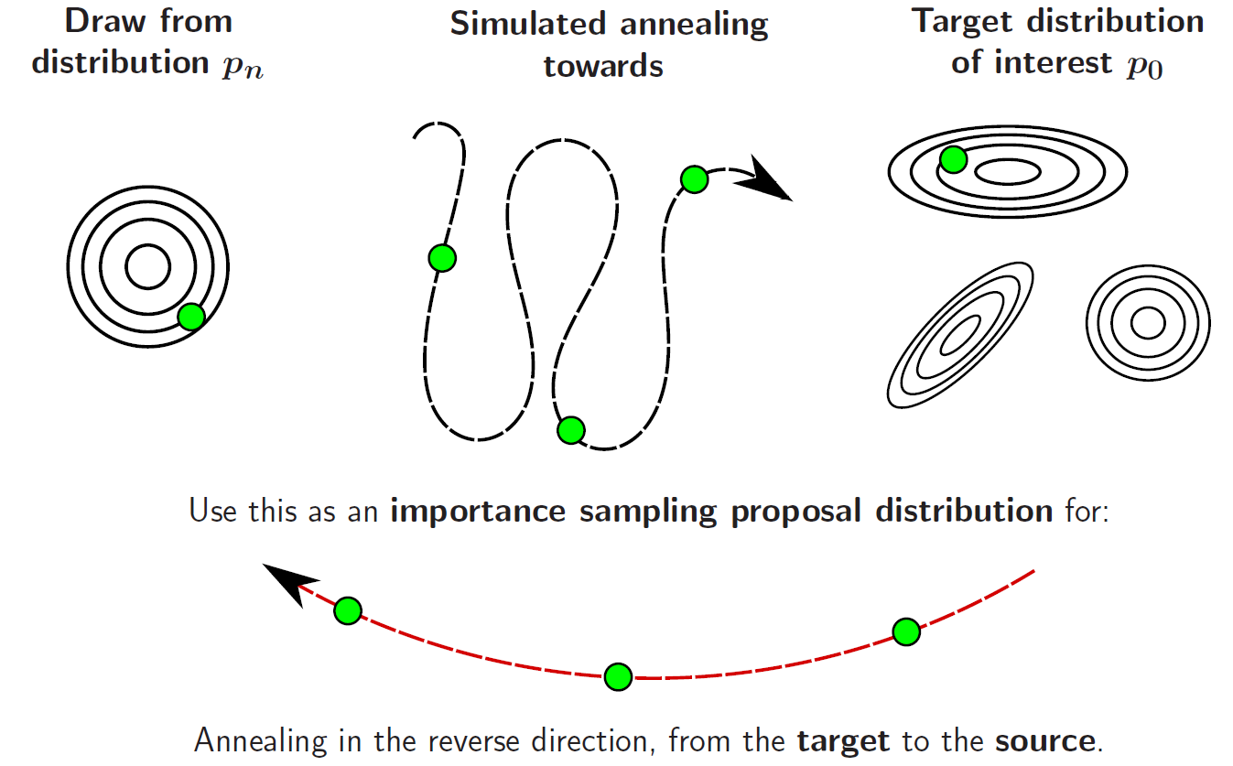
Annealed Importance Sampling (Neal, 2001)
low “temperature”

Slide 17
Annealed Importance Sampling (Neal, 2001)
high “temperature”
low “temperature”

Slide 18
Annealed Importance Sampling (Neal, 2001)
high “temperature”
low “temperature”

Slide 19
Annealed Importance Sampling (Neal, 2001)

Slide 20
Annealed Importance Sampling (Neal, 2001)
Importance samples from the target
An estimate of the ratio of partition functions

Slide 21
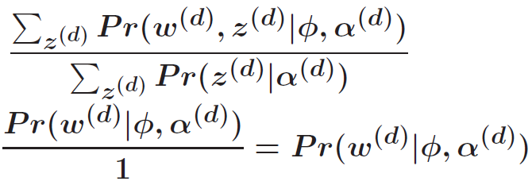
AIS for Evaluating Topic Models (Wallach et al., 2009)
Draw from the prior Anneal towards The posterior

Slide 22
AIS for Evaluating Topic Models (Wallach et al., 2009)
Draw from the prior Anneal towards The posterior

Slide 23
AIS for Evaluating Topic Models (Wallach et al., 2009)
Draw from the prior Anneal towards The posterior

Slide 24
AIS for Evaluating Topic Models (Wallach et al., 2009)
Draw from the prior Anneal towards The posterior

Slide 25
Insights
We are mainly interested in the relative performance of topic models
AIS can provide estimates of the ratio of partition functions of any two distributions that we can anneal between

Slide 26
A standard application of Annealed Importance Sampling (Neal, 2001)
high “temperature”
low “temperature”

Slide 27
The Proposed Method: Ratio-AIS
Draw from Topic Model 2 Anneal towards Topic Model 1
medium “temperature”
medium “temperature”

Slide 28
The Proposed Method: Ratio-AIS
Draw from Topic Model 2 Anneal towards Topic Model 1
medium “temperature”
medium “temperature”

Slide 29
The Proposed Method: Ratio-AIS
Draw from Topic Model 2 Anneal towards Topic Model 1
medium “temperature”
medium “temperature”

Slide 30
Advantages of Ratio-AIS
Ratio-AIS avoids several sources of Monte Carlo error for comparing two models. The standard method
estimates the denominator of a ratio even though it is a constant (=1),
uses different z’s for both models,
and is run twice, introducing Monte Carlo noise each time.
An easy convergence check: anneal in the reverse direction to compute the reciprocal.

Slide 31
Annealing Paths Between Topic Models
Geometric average of the two distributions
Convex combination of the parameters

Slide 32
Efficiently Plotting Performance Per Iteration of the Learning Algorithm
(Foulds et al., 2013)

Slide 33
Insights
Fsf
2sfd
We can select the AIS intermediate distributions to be distributions of interest
The sequence of models we reach during training is typically amenable to annealing
The early models are often low temperature
Each successive model is similar to the previous one

Slide 34
Iteration-AIS
Re-uses all previous computation
Warm starts
More annealing temperatures, for free
Importance weights can be computed recursively
Topic Model at
Topic Model at
Topic Model at
Anneal from Prior Iteration 1 Iteration 2 … Iteration N
Wallach et al.
Ratio AIS
Ratio AIS
Ratio AIS

Slide 35
Iteration-AIS
Re-uses all previous computation
Warm starts
More annealing temperatures, for free
Importance weights can be computed recursively
Topic Model at
Topic Model at
Topic Model at
Anneal from Prior Iteration 1 Iteration 2 … Iteration N
Wallach et al.
Ratio AIS
Ratio AIS
Ratio AIS

Slide 36
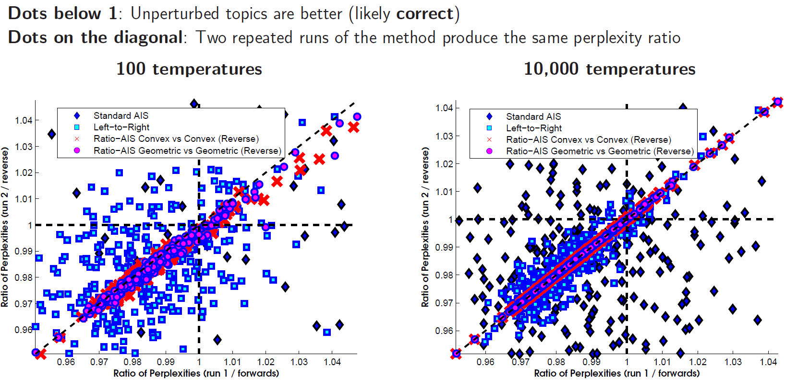
Comparing Very Similar Topic Models (ACL Corpus)

Slide 37
Comparing Very Similar Topic Models (ACL and NIPS)
% Accuracy

Slide 38
Symmetric vs Asymmetric Priors (NIPS, 1000 temperatures or equiv.)
Correlation with longer left-to-right run
Variance of the estimate of relative log-likelihood

Slide 39
Symmetric vs Asymmetric Priors (NIPS, 1000 temperatures or equiv.)
Correlation with longer left-to-right run
Variance of the estimate of relative log-likelihood

Slide 40
Symmetric vs Asymmetric Priors (NIPS, 1000 temperatures or equiv.)
Correlation with longer left-to-right run
Variance of the estimate of relative log-likelihood

Slide 41
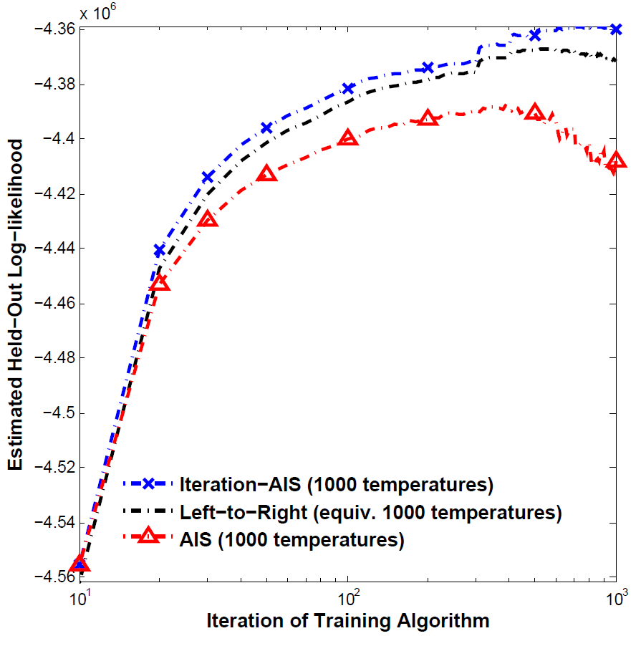
Per-Iteration Evaluation, ACL Dataset

Slide 42
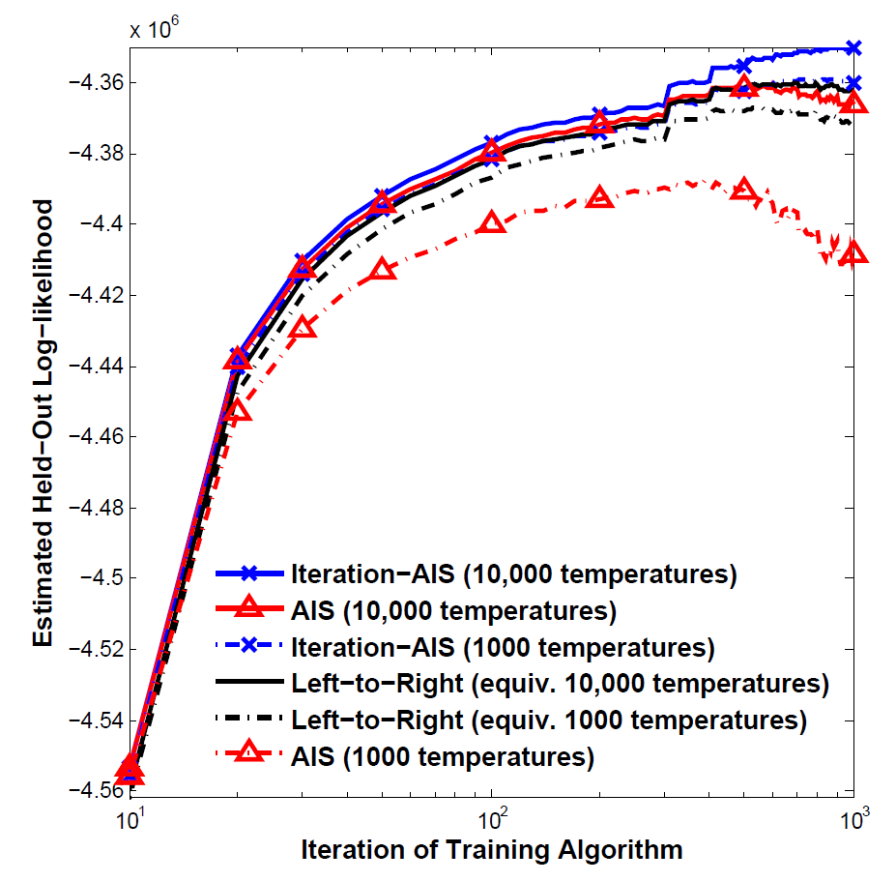
Per-Iteration Evaluation, ACL Dataset

Slide 43
Conclusions
Use Ratio-AIS for detailed document-level analysis
Run the annealing in both directions to check for convergence failures
Use Left to Right for corpus-level analysis
Use Iteration-AIS to evaluate training algorithms

Slide 44
Future Directions
The ratio-AIS and iteration-AIS ideas can potentially be applied to other models with intractable likelihoods or partition functions (e.g. RBMs, ERGMs)
Other annealing paths may be possible
Evaluating topic models remains an important, computationally challenging problem

Slide 45
Thank You!
Questions?

